Slide 1

CAR PRICE PREDICTION
Using Machine Learning Algorithms
Created by-
Kunal Chand
Internship 19

Slide 2

INTRODUCTION
Build a model which can be used to predict the valuation of the used cars after covid-19 impact ,weather the cars getting higher value or due do time value is depreciated even more lets find out all these things using A.I and Machine learning.

Slide 3
The 7 Key Steps To Build Your Machine Learning Model
Step 1: Collect Data.
Step 2: Prepare the data.
Step 3: Choose the model.
Step 4 Train your machine model.
Step 5: Evaluation.
Step 6: Parameter Tuning.
Step 7: Prediction or Inference.

Slide 4
Data Exploration
Data exploration is the first step in data analysis and typically involves summarizing the main characteristics of a data set, including its size, accuracy, initial patterns in the data, and other attributes.
It is commonly conducted by data analysts using visual analytics tools, but it can also be done in more advanced statistical software, Python. Before it can analyze data collected by multiple data sources and stored in data warehouses, an organization must know how many cases are in a data set, what variables are included, how many missing values there are, and what general hypotheses the data is likely to support.
An initial exploration of the data set can help answer these questions by familiarizing analysts with the data with which they are working. We divided the data 8:2 for Training and Testing purposes respectively.

Slide 5
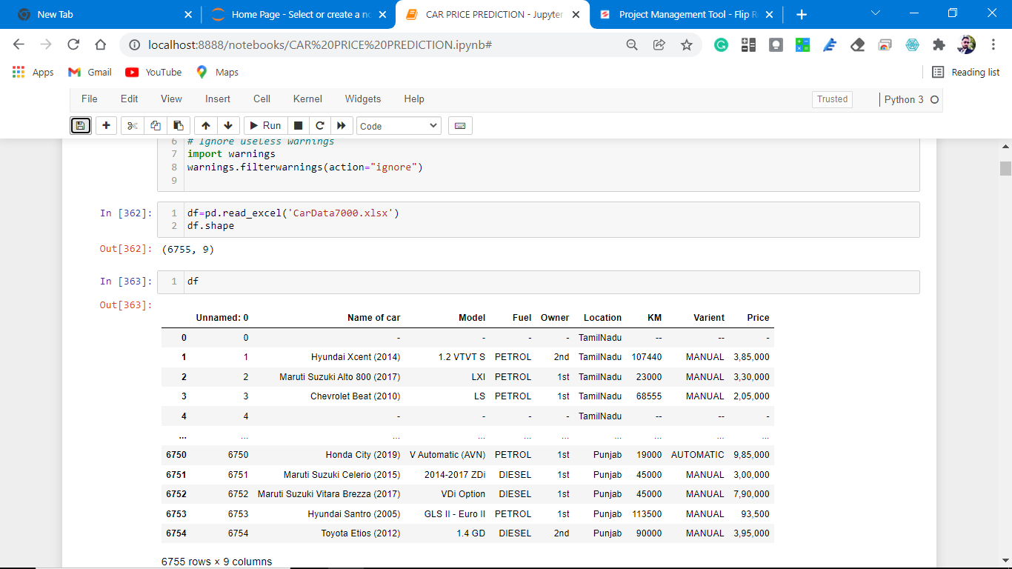
Data Sources and their formats
As in this project, we have to scrap a minimum of 5000 used cars data from different available used car sites present at different websites, and for that, we use python and selenium to scrap data from olx autos and save them in excel format.
After loading the data in python and making a frame our dataset looks like this.
Dataset looks as follows-

Slide 6
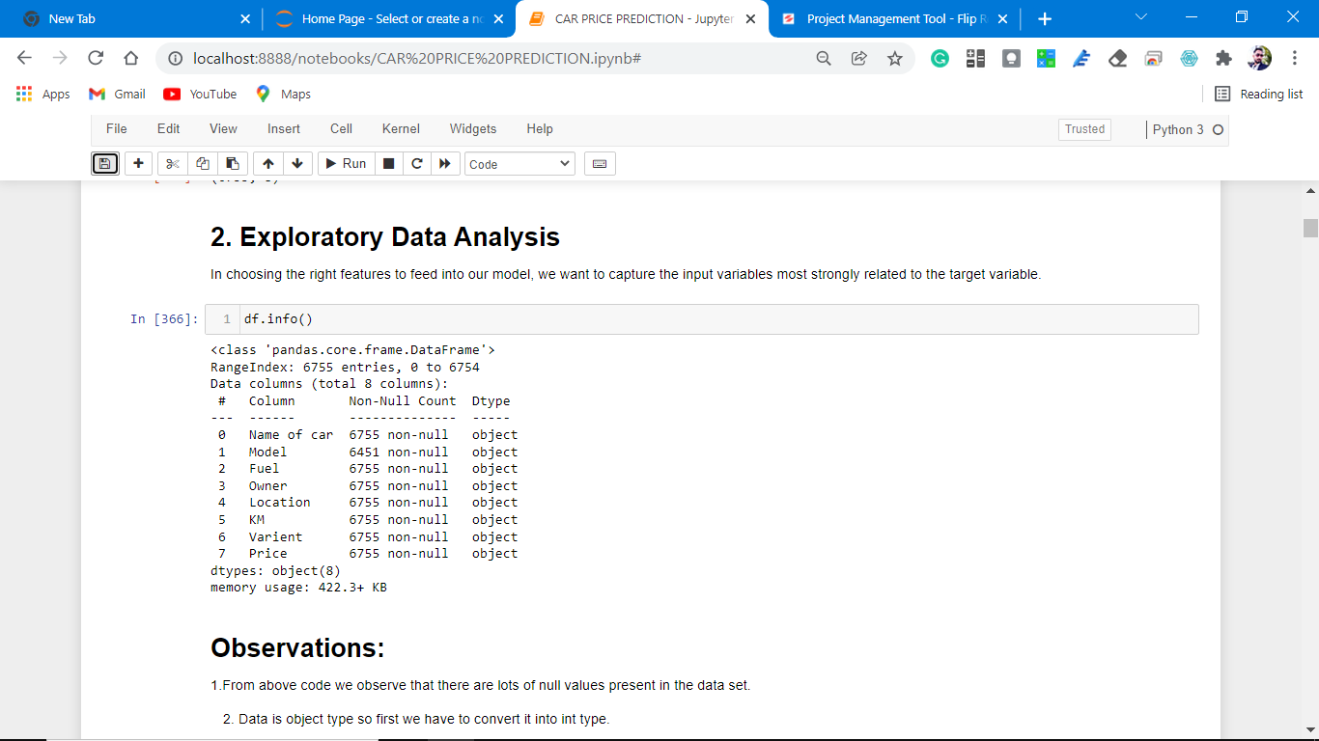
Dataset Information looks as follows-
The data is float type so we have to convert data into int type.

Slide 7
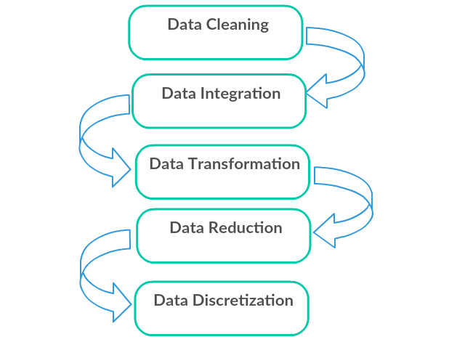
Data Pre-processing Done
Data pre-processing can refer to the manipulation or dropping of data before it is used to ensure or enhance performance, and is an important step in the data mining process.

Slide 8
Data Cleaning: First we clean the data which have no use in prediction like the S.no column and Location, then we drop the data which has a high no of missing percentages.
Data Integration: then we do some EDA process for finding out the meaning full insights of the data.
Data transformation is the process of changing the format, structure, or values of data; we use a labeled encoder for coding the object data into integer data.
Data Reduction: it is the process of finding the most correlated columns, and combining them because the machine does not understand which feature columns impact the most on accuracy.
Data discretization converts a large number of data values into smaller once, so that data evaluation and data management becomes very easy, using box plots is makes a clear understanding of the data.

Slide 9
EDA Concluding Remark.
As for any basic model building, we have to understand the type of target variable, the data of the target variable is continued or classified.
Data Analysis is always the difficult part, for better understanding different kinds of bar plots, distribution plots are created with the target Column for finding the insights of the dataset we have.
Analytical Modelling always starts with the target variable we have, and in that case, our target variable is Price, for that, we create some distribution plots with the target variable to understand which feature columns help to learn the model best and which feature columns reduce the accuracy of the model.
And after finding the relation and correlation with the target variable we choose either Regression Model or Classification Model. Here in this problem, our target feature column is continuous so we build our Machine Learning model on Regression.

Slide 10
Data Cleaning
Data cleaning is essential part of m.l model.
When we initialize the data set we observe that dataset having many null values and special character, first we replace the special characters with Nan values and after that we remove all the Nan values from the dataset.
Missing values are there in heat map plotting which we remove.

Slide 11
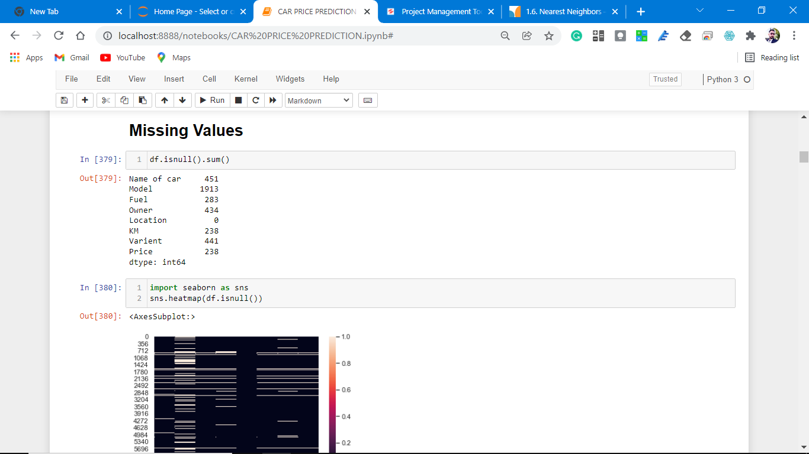
Missing values

Slide 12
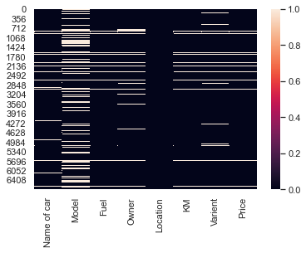
Heat map plotting
Observations:
1. From the above code we observe that there are lots of white spots which are null values in the dataset.
2. we have to understand the missing values and fill with proper values or drop them permanently.

Slide 13
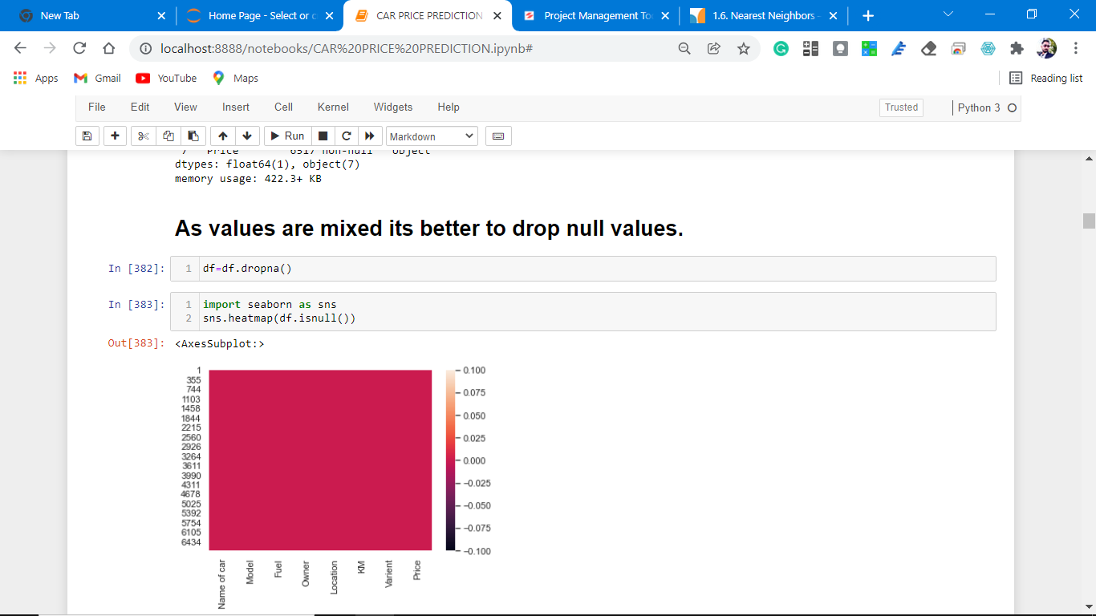
Dropping all the null values

Slide 14
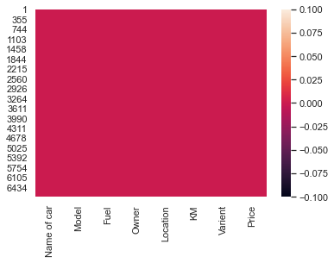
Heat map plotting.
Observations:
As observed from the above there is no null values count.
2.we can easily visualize this heat map plotting.

Slide 15
Visualization
Data visualization is the graphical representation of information and data. By using charts, plots, and graphs data visualization tools provide an accessible way to see and understand trends, outliers, and patterns in data.
In the world of Big Data, data visualization tools and technologies are essential to analyze massive amounts of information and make data-driven decisions.
.

Slide 16
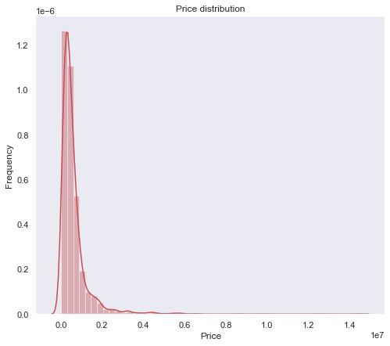
Visualization.
Visualization of the target varible.
Observations:
1. As seen from the above distribution plot that data is not normally distributed.
2. data is skewed towards the right.
3. Remove the skewness to make data normally distributed, M.L models understand normally data more clearly and perform better prediction

Slide 17
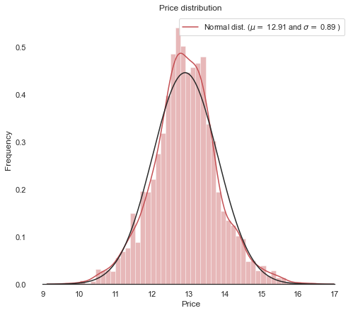
Normalization of target variable.
Observations:
1. As we see our price attribute is now normally distributed.

Slide 18
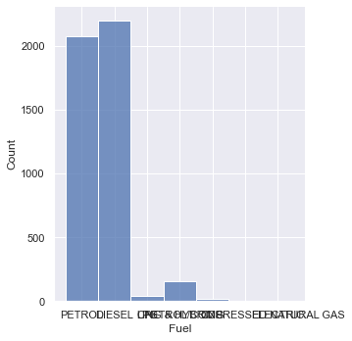
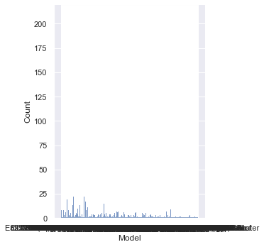
Visualization:
Univariate Analysis

Slide 19
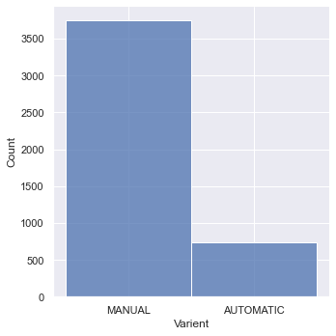
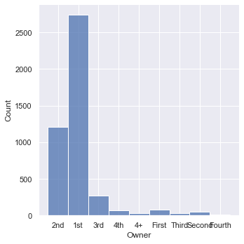

Slide 20
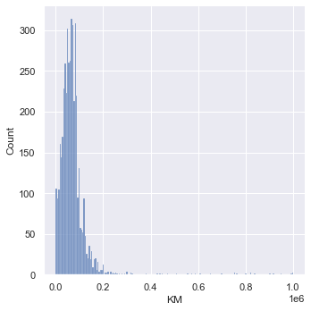
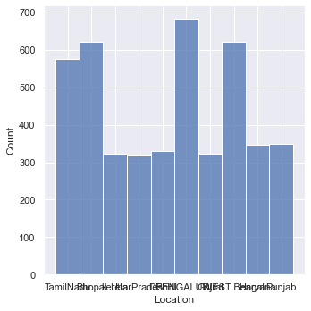

Slide 21
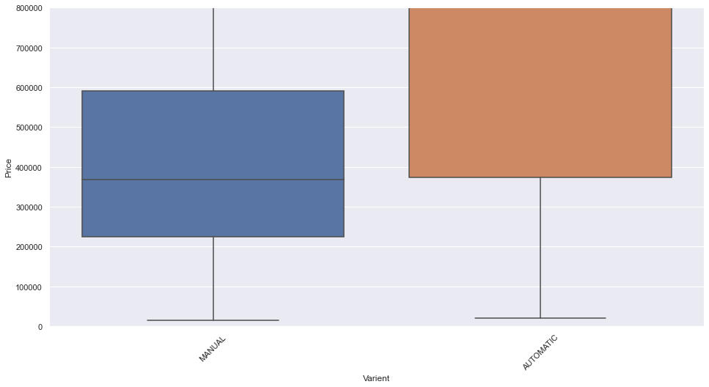
Bivariate analysis for better understanding which features columns is impacting more on Predicting Prices.
Price vs. variant of the car.
Observations:
1. Classes are not equal.
2. Both the segments have different price bands, automatic vehicles are more expensive than the manual transmission.

Slide 22
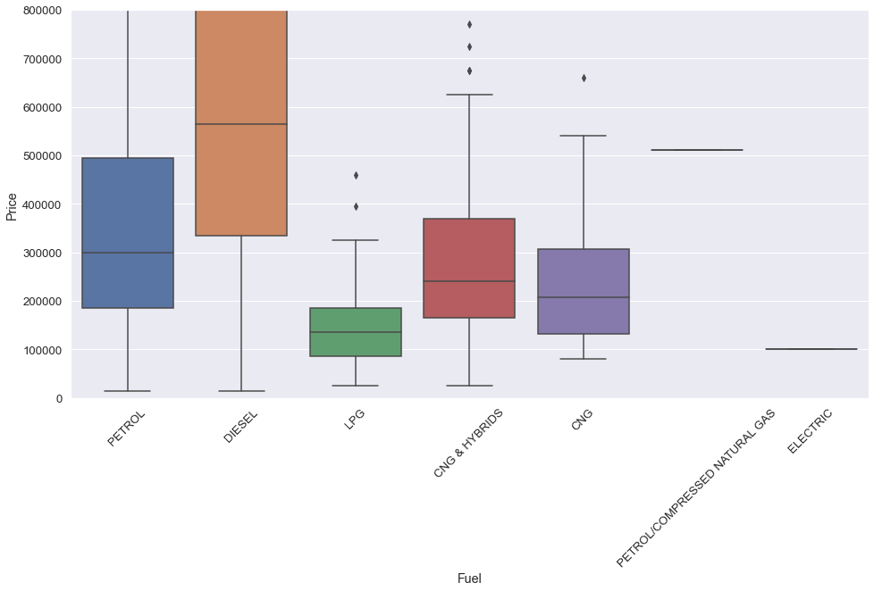
Price vs fuel options.
Observations:
1. Diesel car having more price range.
2. petrol vehicles on 2nd spot in the price range.
3. CNG and hybrid cars are in the 3rd spot in the price range.

Slide 23
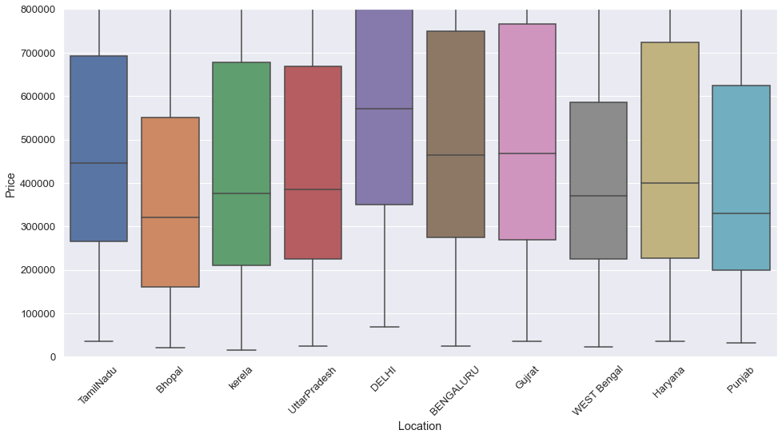
Price with Location

Slide 24
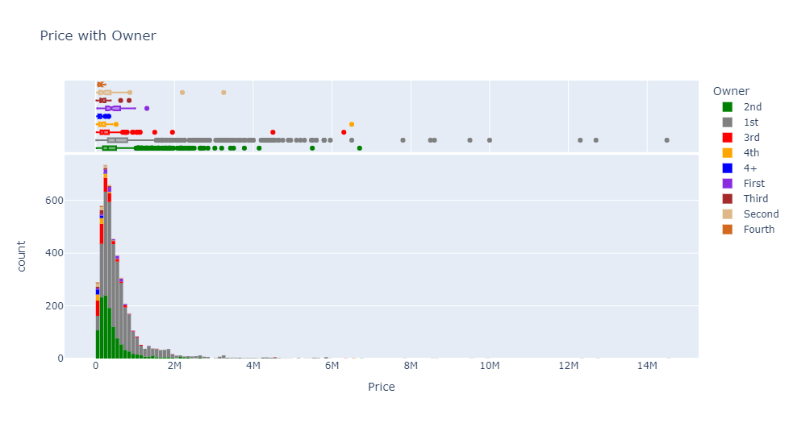
Price with Owner

Slide 25
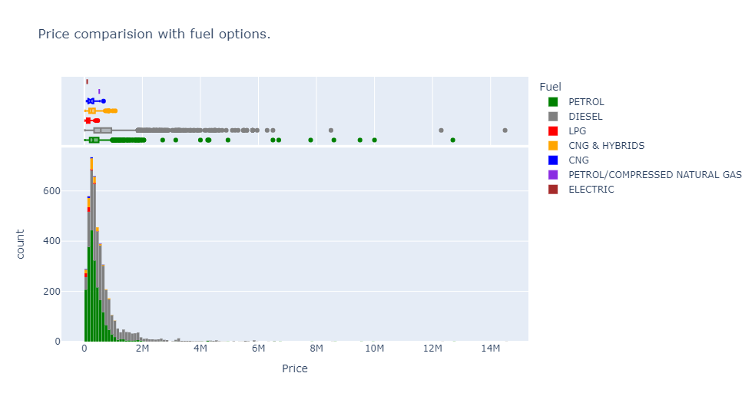
Price comparison with fuel options

Slide 26
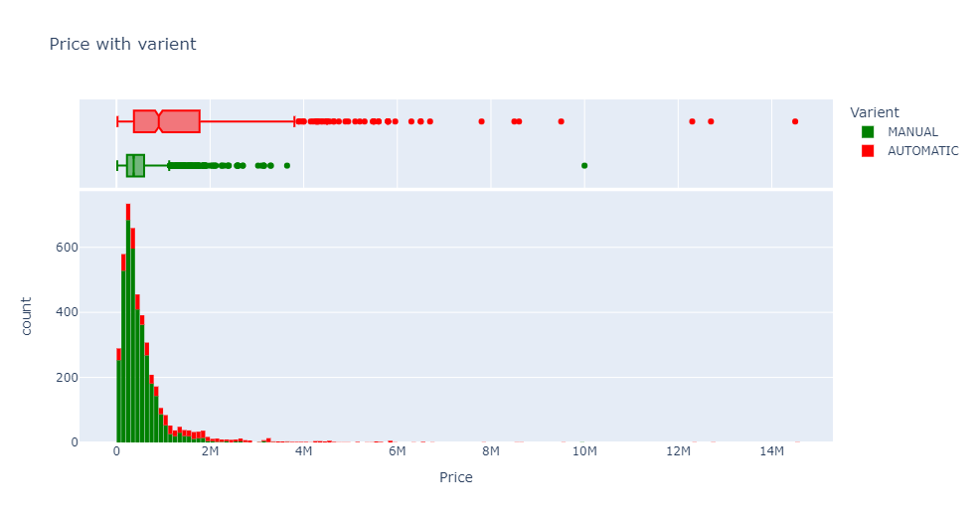
Price with varient

Slide 27
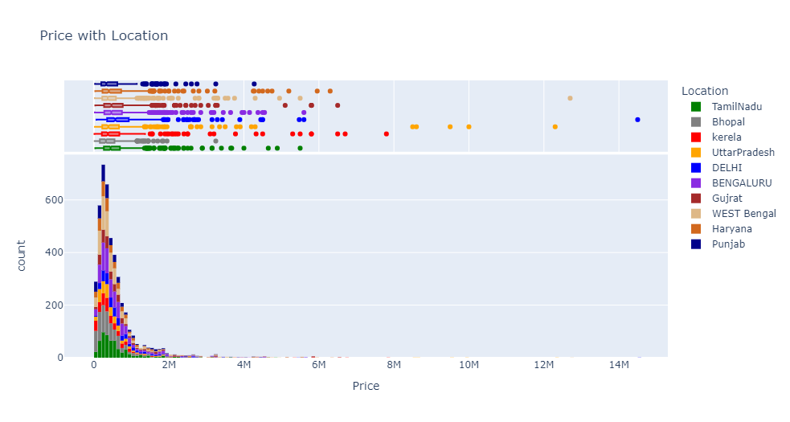
Cars with varient

Slide 28
Price with Location

Slide 29
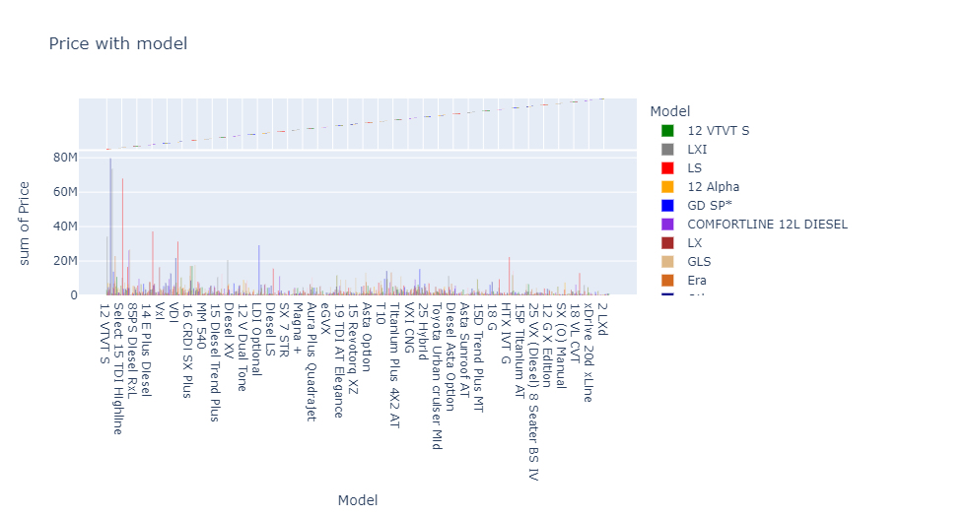
Price with model

Slide 30
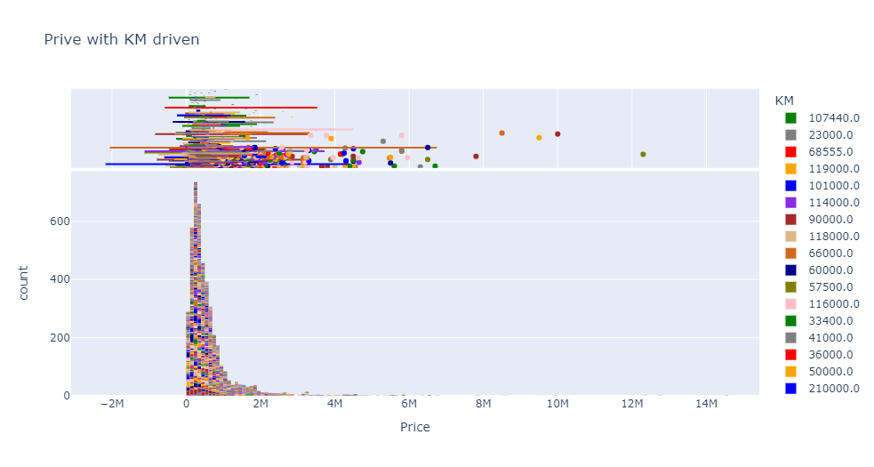
Price with km driven.

Slide 31
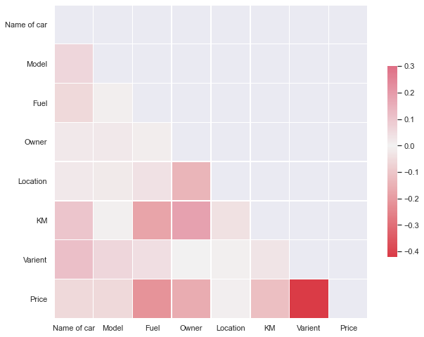
Correlation with the target variable.

Slide 32
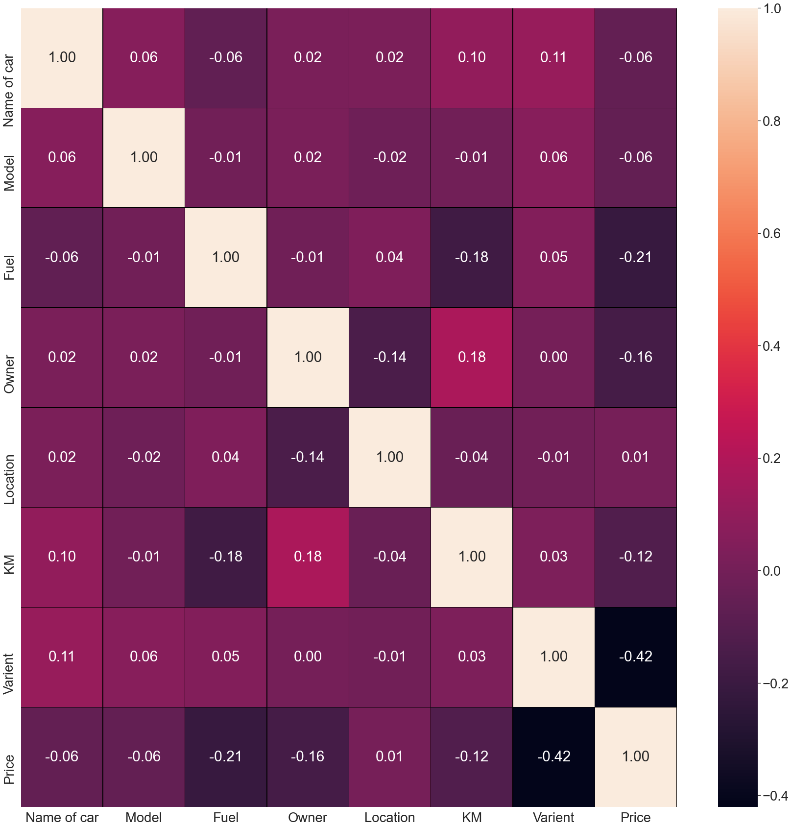
Heat map plotting with notations.

Slide 33
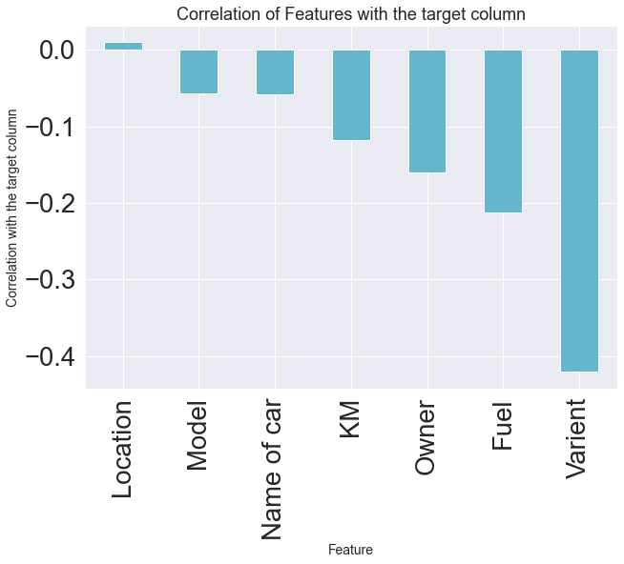
Correlation with target variables.

Slide 34
Observations:
1. From the above result it is clear that some columns make a positive correlation and some make a negative correlation.
2. The positively correlated columns have a great impact on the target column while the negatively correlated have less or zero impact on the target column.
3. when we plot the heat map with notations is true. we can easily observe correlation.
4. All the columns are negatively correlated with the Price column except location.
5. hence no feature column is increasing the price of the car.
5. Some feature columns are negative which impacts on accuracy and learning of the M.L model.

Slide 35
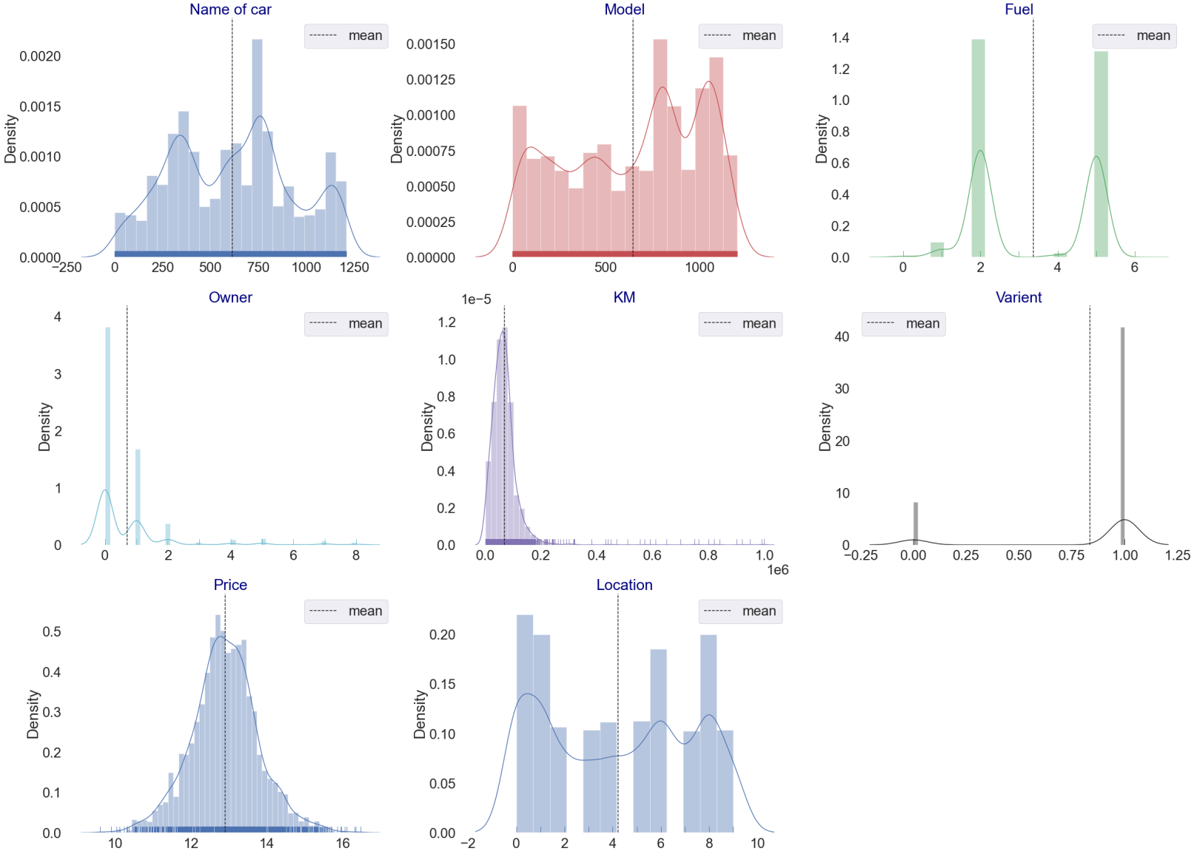
Plotting feature columns and checking skewness.

Slide 36
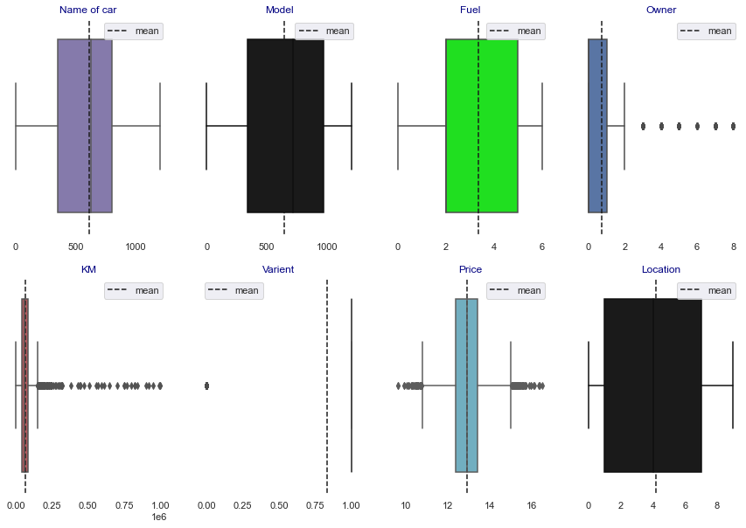
Plotting outliers.
Observations:
1. From the above plotting we see that outliers are present in the dataset.
2. Most outliers are present in KM and Price column.

Slide 37
Building Machine Learning Models
After analyzing the dataset, I observe that many of the feature columns are object types so first, we have to convert them into integer or float types so that the machine interprets the data and for that we do label encode all the features column.
After label encoding, we find that many feature columns have Nan values so we remove them completely because we do valuation of a used car.
Then find the correlation between the columns with target columns and delete the non-related feature columns.
We observe that the target column is skewed so we remove the skewness of the target column because normal data gives better results when we make the M.L model.
The target column is continuous type so we start work on Regression models building.

Slide 38
Testing of Identified Approaches (Algorithms)
Testing of Identified Approaches (Algorithms)
Logistic Regression
Regurgitation:
Lasso regression
Ridge Regression
3. Decision Tree Regression
4. Ensemble techniques
Gradient Boosting Regression
Random forest Regression.
5. Support vector machine
6. K-nearest neighbours

Slide 39
Logistic Regression Model
Logistic Regression is a machine learning algorithm based on supervised learning.
• It performs a regression task. Regression models a target prediction value based on independent variables.
• It is mostly used for finding out the relationship between variables and forecasting

Slide 40
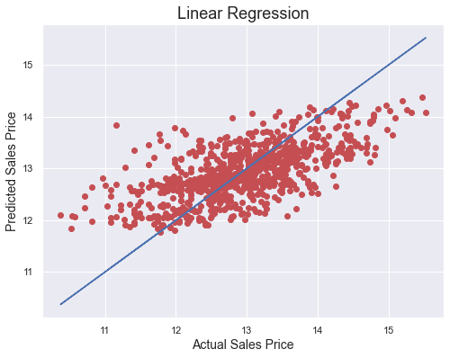
At random_state:- 31
Training r2_score is:- 37.14268657579035
Testing r2_score is:- 42.306525900049785
The model is not so accurate; let's do some regularization.

Slide 41
Regularization 1. Lasso Regression
To correctly fit in our model let's do some regulation.
The Lasso is a linear model that estimates sparse coefficients. It is useful in some contexts due to its tendency to prefer solutions with fewer non-zero coefficients, effectively reducing the number of features upon which the given solution is dependent. For this reason, Lasso and its variants are fundamental to the field of compressed sensing. Under certain conditions, it can recover the exact set of non-zero coefficients (see Compressive sensing: tomography reconstruction with L1 prior (Lasso)).

Slide 42

Observations:
1. This model is non-performing well.
2. There is a major difference between cross-validation and accuracy matrices.
Cross-Validation.
At cv:- 11
Cross-validation score is:- 33.584556993368686
R2_score is:- 42.06893076535947

Slide 43
2. Ridge Regression
Ridge regression addresses some of the problems of Ordinary Least Squares by imposing a penalty on the size of the coefficients. The ridge coefficients minimize a penalized residual sum of squares:

Slide 44
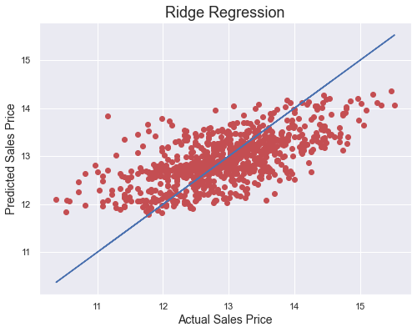
Observation:
1. Not performing well.
At cv:- 10
Cross Val Score: 34.09083568790876
R2 Score: 42.25130842297562

Slide 45
Decision Tree Classifier
Decision Trees (DTs) are a non-parametric supervised learning method used for classification and regression. The goal is to create a model that predicts the value of a target variable by learning simple decision rules inferred from the data features. A tree can be seen as a piecewise constant approximation.
For instance, in the example below, decision trees learn from data to approximate a sine curve with a set of if-then-else decision rules. The deeper the tree, the more complex the decision rules, and the fitter the model.

Slide 46
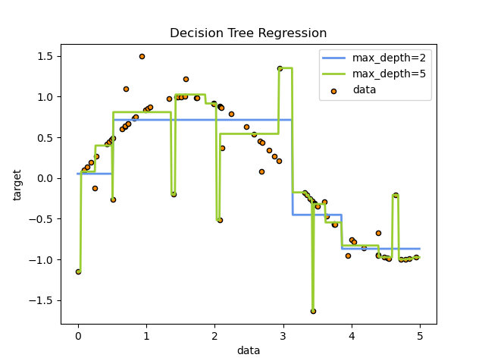

Slide 47
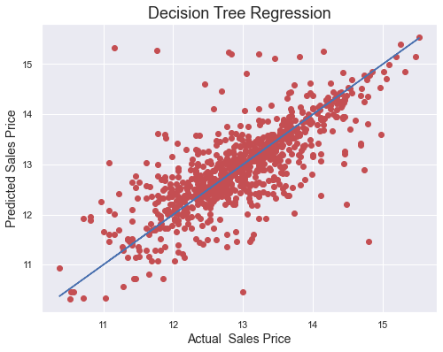
Observations:
This Decision Tree regression Performs with 52% accuracy for predicting frauds.After predicting and plotting the predicted data on the best fit line we observe that DT-C is not so accurate.
CV is not well. And does not give accurate results.
Cross-Validation.
At cv:- 12
R2 Score: 51.6826962870226
Cross Val Score: 44.63614813186459

Slide 48
Ensemble methods
1. Gradient Tree Boosting
Gradient Tree Boosting or Gradient Boosted Decision Trees (GBDT) is a generalization of boosting to arbitrary differentiable loss functions. GBDT is an accurate and effective off-the-shelf procedure that can be used for both regression and classification problems in a variety of areas including Web search ranking and ecology.

Slide 49
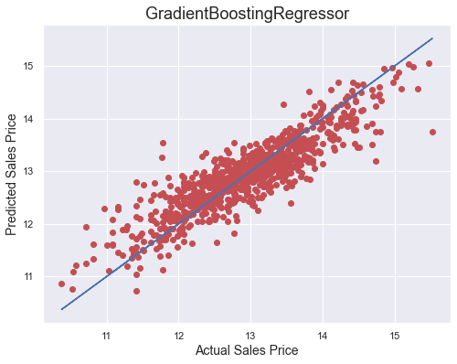
Observation:
This algorithm performs better than the above algorithms.
At cv:- 17
R2 Score: 77.94710770113188
Cross Val Score: 74.3798966811026

Slide 50
Key Metrics
Mean Absolute Error
Mean Squared Error
Root Mean Square Error
This matrix helps to understand the model more deeply.

Slide 51
Concluding Remarks.
So, our Aim is achieved as we have successfully ticked all our parameters as mentioned in our Aim Column. It is seen Location is the most effective attribute in predicting the label column and that the Gradient Boosting regression is the most effective model for our Dataset with cv and accuracy is 78%.

Slide 52
Interpretation of the Results
We tested 8 models out of which Gradient Boosting Regressor performed Best as Accuracy score and CV is Optimum.
The best model is Gradient Boosting Regressor. Since the difference between the percentage score of cross-validation and r2_score is optimum.
At cv:- 17
R2 Score: 77.94710770113188¶
Cross Val Score: 74.3798966811026
.

Slide 53
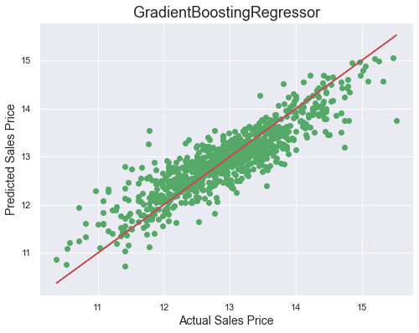

Slide 54
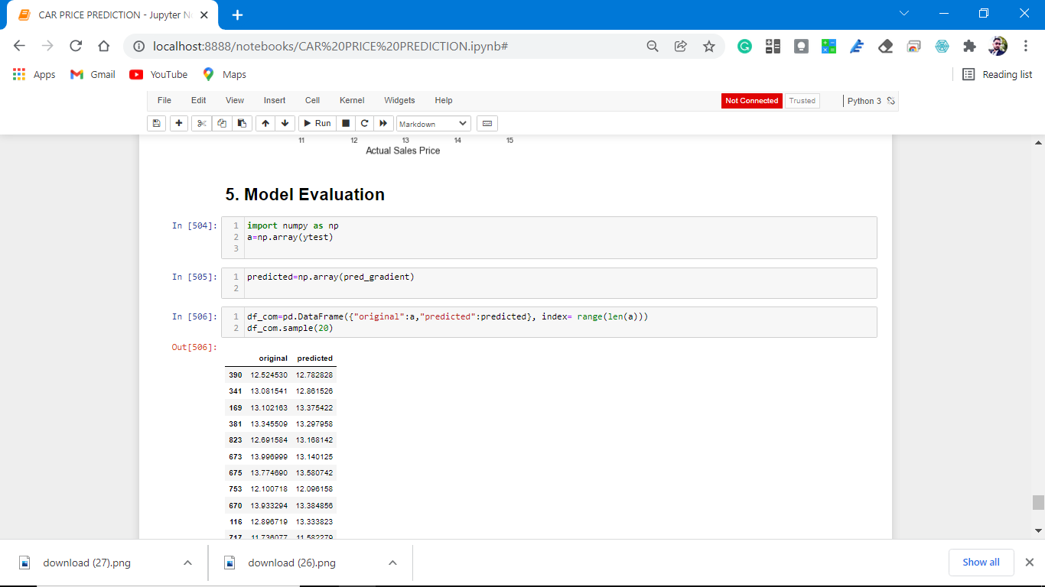

Slide 55
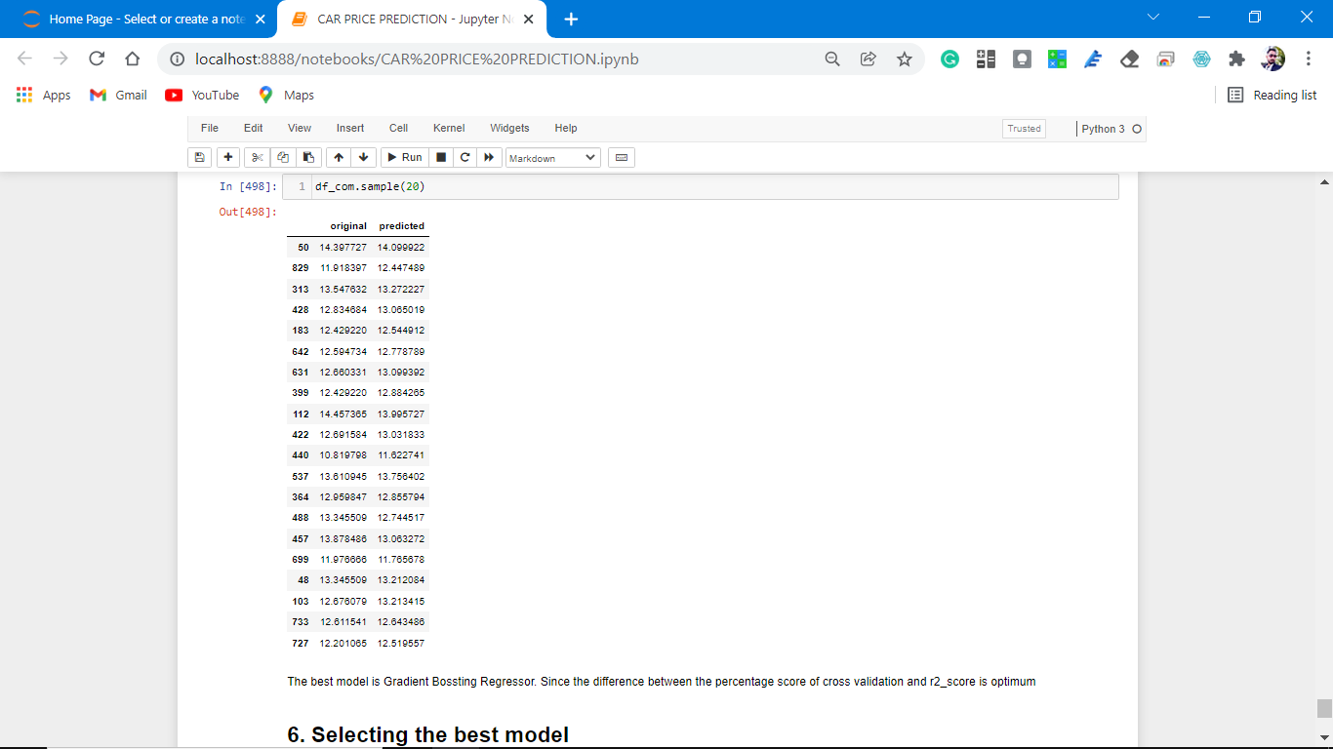

Slide 56
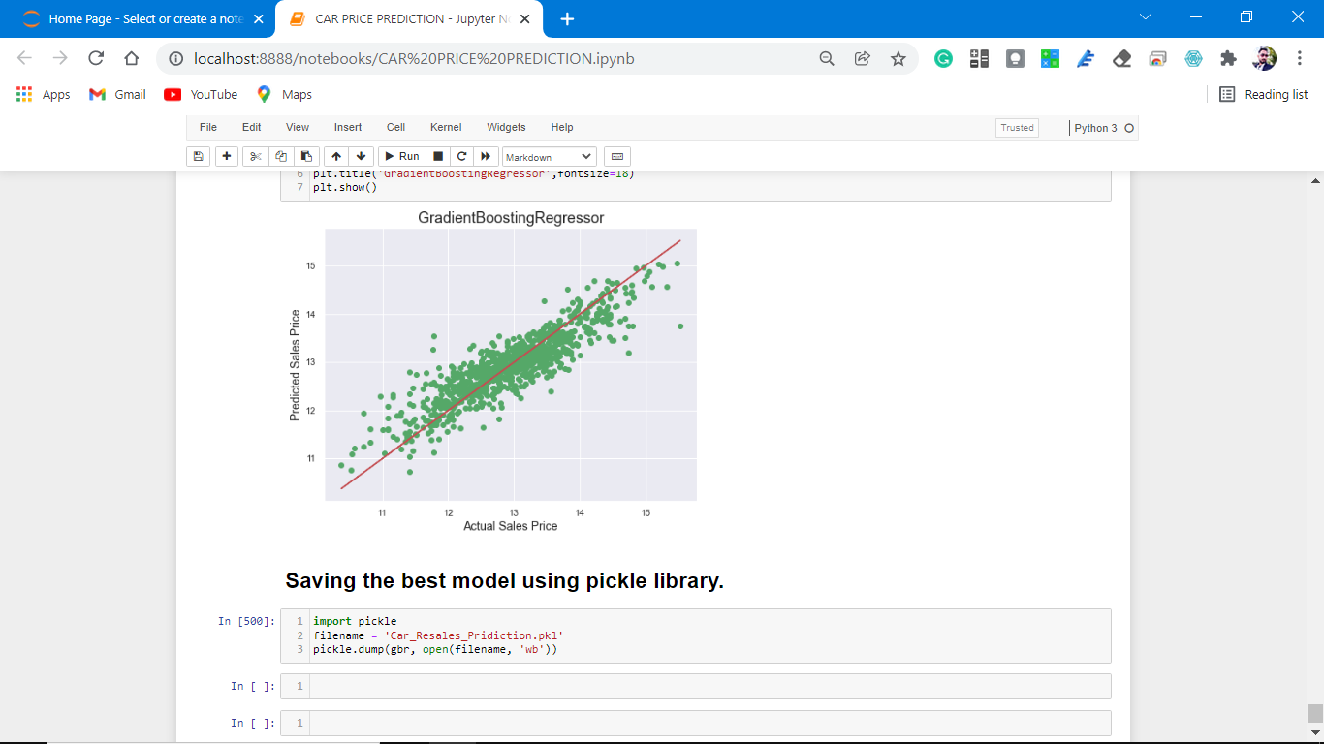

Slide 57
That's it! We reached the end of our exercise.
Throughout this kernel, we put into practice many of the strategies for predicting the resale value of the cars. We philosophized about the variables, we analyzed 'Price' alone and with the most correlated variables, we dealt with missing data and outliers, we tested some of the fundamental statistical assumptions and we even transformed object variables into int variables. That's a lot of work that Python helped us make easier.

Slide 58
Thank you

